Slide 1

1151CS113-COMPUTER GRAPHICS AND IMAGE PROCESSING UNIT II SHADING
SCHOOL OF COMPUTING
DEPARTMENT OF COMPUTER SCIENCE & ENGINEERING
PRESENTED BY
RAGHAVENDRAN.S ASSISTANT PROFESSOR
TTS1541

Slide 2
COMPUTER GRAPHICS AND IMAGE PROCESSING
Course Category: Program Core
Pre-requisite
Link to Other courses
Multimedia Systems
Computer Vision
SL.NO | Course Code | Course Name
1 | 1150MA103 | Engineering Mathematics 2
2 | 1150CS201 | Problem Solving using C

Slide 3
COMPUTER GRAPHICS AND IMAGE PROCESSING
Course Outcomes
CO Nos. | Course Outcomes | Level of learning domain (Based on revised Bloom’s taxonomy)
CO1 | Explain about basics of Computer Graphics | K2
CO2 | Summarize in the Shading models | K2
CO3 | Explain various Advance Modeling Techniques | K2
CO4 | Summarize in Basic of Image Processing | K2
CO5 | Explain various image restoration techniques | K3

Slide 4
COMPUTER GRAPHICS AND IMAGE PROCESSING
UNIT II SHADING
Parallel projection-Perspective projection, Buffer algorithm, Scan line algorithm. Area subdivision and Ray tracing algorithms. Illumination model, Specular reflection model, Shading models for curve surfaces, Recursive ray tracing, Texture mapping
REFERENCES
Hearn & Baker, “Computer Graphics C version”, 2nd ed. Pearson Education, 2012.
www.slideshare.net/.../computer-graphics-image-processing-lecture-n.

Slide 5
Shading
Shading refers to the depiction of depth perception in 3D models (within the field of 3D computer graphics) or illustrations (in visual art) by varying the level of darkness.
Shading tries to approximate local behavior of light on the object's surface and is not to be confused with techniques of adding shadows, such as shadow mapping or shadow volumes, which fall under global behavior of light.
Definition
In computer graphics, shading refers to the process of altering the color of an object/surface/polygon in the 3D scene, based on things like (but not limited to) the surface's angle to lights, its distance from lights, its angle to the camera and material properties (e.g. bidirectional reflectance distribution function)

Slide 6
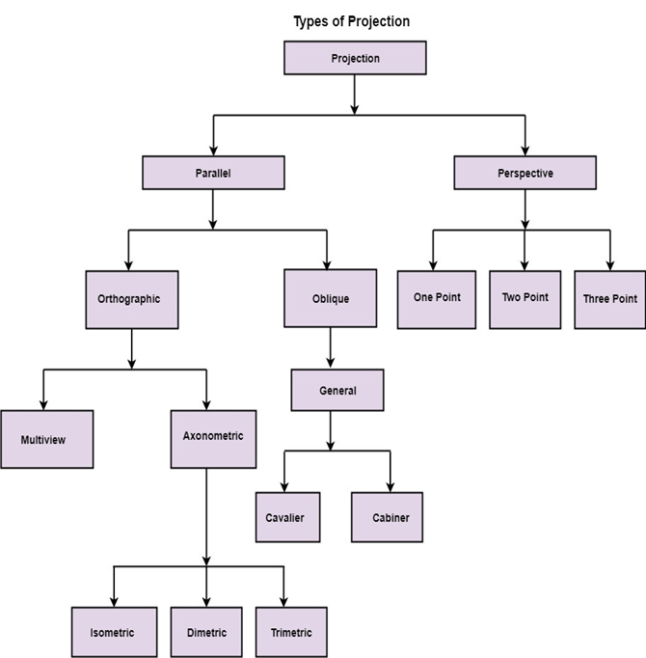
Projection
It is the process of converting a 3D object into a 2D object. It is also defined as mapping or transformation of the object in projection plane or view plane. The view plane is displayed surface.

Slide 7
Parallel Projection
Parallel projection is said to be parallel if the centre of the projection is at infinite distance to the projected plane
Parallel Projection use to display picture in its true shape and size. When projectors are perpendicular to view plane then is called orthographic projection.
The parallel projection is formed by extending parallel lines from each vertex on the object until they intersect the plane of the screen. The point of intersection is the projection of vertex.
Parallel projections are used by architects and engineers for creating working drawing of the object, for complete representations require two or more views of an object using different planes.

Slide 8
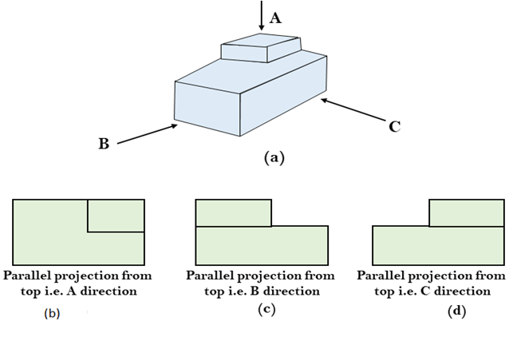
Parallel Projection

Slide 9
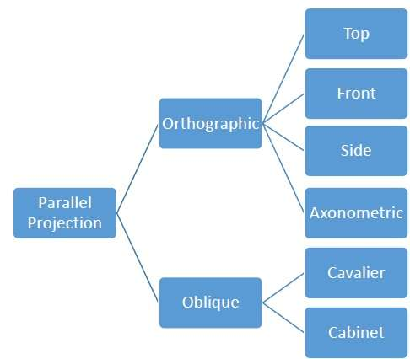
Parallel Projection
Parallel projections are less realistic, but they are good for exact measurements. In this type of projections, parallel lines remain parallel and angles are not preserved. Various types of parallel projections are shown in the following hierarchy.

Slide 10
Orthographic Projection
Orthographic projection common method of representing three-dimensional objects, usually by two-dimensional drawings in each of which the object is viewed along parallel lines that are perpendicular to the plane of the drawing.
For example, an orthographic projection of a house typically consists of a top view, or plan, and a front view and one side view (front and side elevations).
In orthographic projection the direction of projection is normal to the projection of the plane. There are three types of orthographic projections −
Front Projection
Top Projection
Side Projection

Slide 11
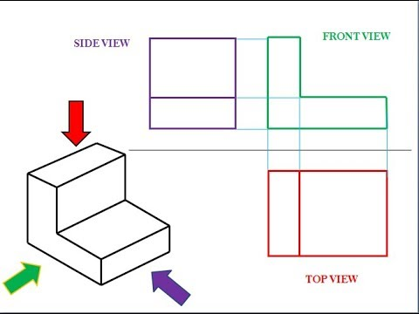
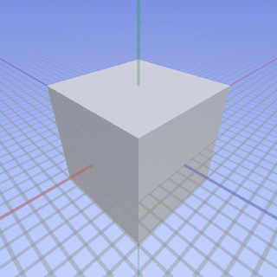
Orthographic Projection

Slide 12
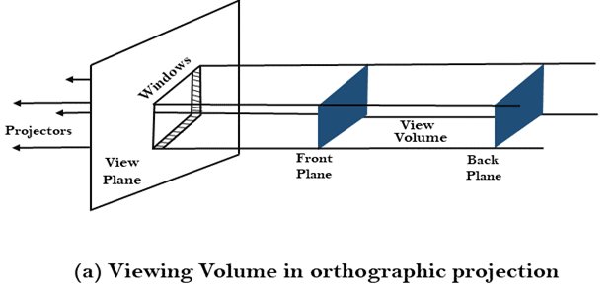
Orthographic Projection

Slide 13
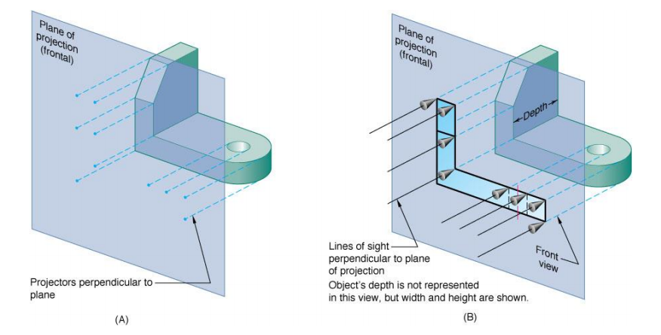
Multiview Orthographic Projection
An orthographic projection for which the object is behind the projection plane, and the object is oriented such that only two of its dimensions are shown.

Slide 14
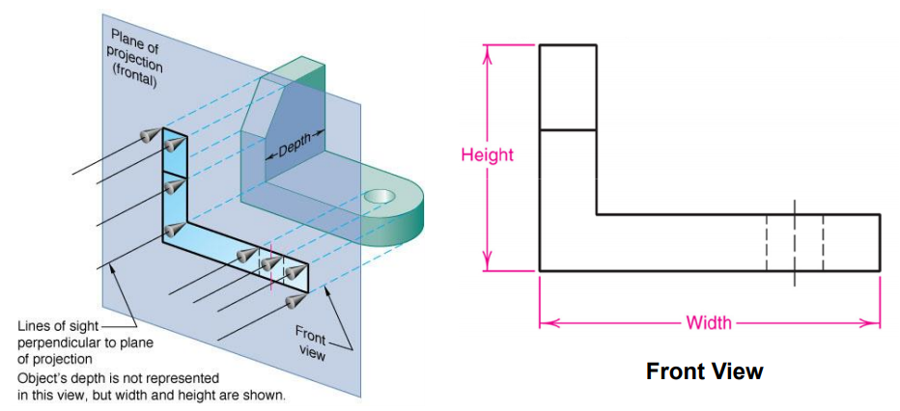
Multiview Orthographic Projection
Multiview drawings – Three views of object are drawn. Each view is a 2D flat image. The views are defined according to the positions of the planes of projection with respect to the object.
Front View – Shows the width and height. Frontal plane is the plane onto which the front view of a multiview drawing is projected.

Slide 15
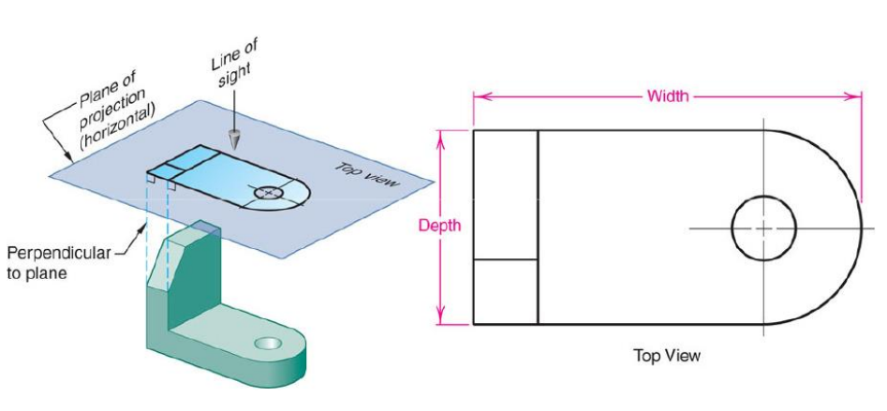
Multiview Orthographic Projection
Top View – Shows the width and depth. The top view is projected onto the horizontal plane of projection.

Slide 16
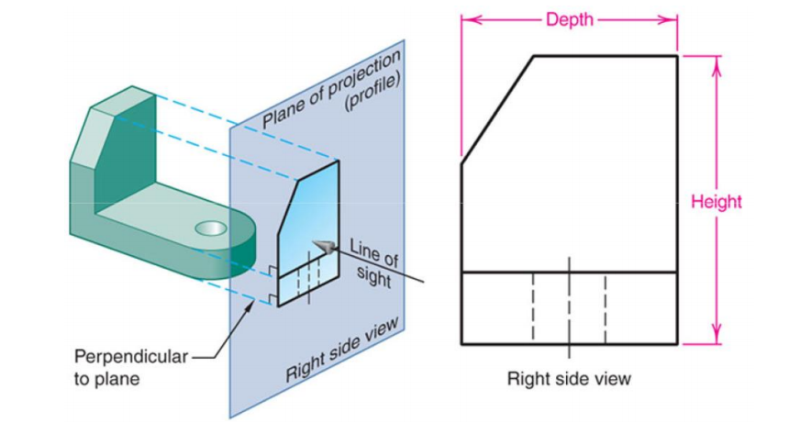
Multiview Orthographic Projection
Side View – Shows the depth and height dimensions. The right side view is projected onto the right profile plane of projection.

Slide 17
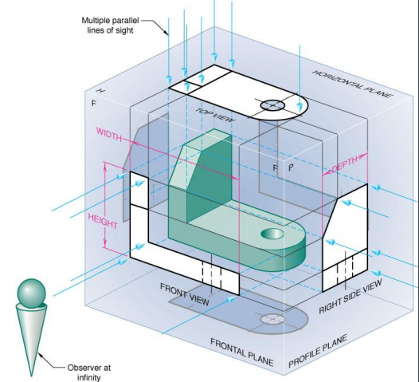
The Six Principal Views
Principal views - the six mutually perpendicular views that are produced by six mutually perpendicular planes of projection.
The six principal views are front, top, left side, right side, bottom and rear.

Slide 18
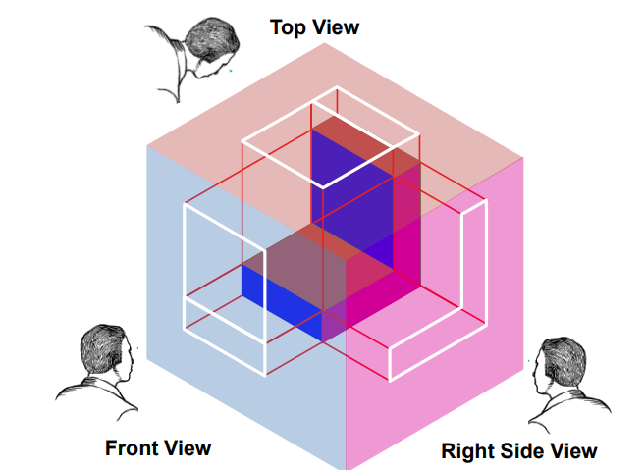
The Six Principal Views

Slide 19
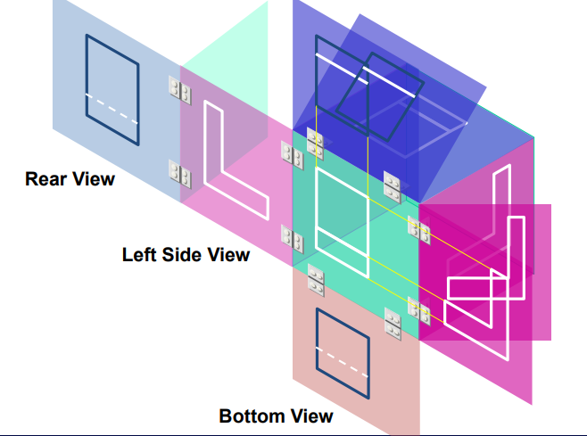
The Six Principal Views

Slide 20
Axonometric projections
Axonometric projections are parallel projections onto an oblique plane. Axonometric projections have the advantage that they give a pictorial view of the object, yet dimensions are measurable.
Manually, axonometric views can be constructed from orthographic views. This is best illustrated by an example. The construction in Figure 1 shows a cube in plan and elevation, from which an axonometric view of the cube is constructed in a direction parallel to one of its diagonals.

Slide 21
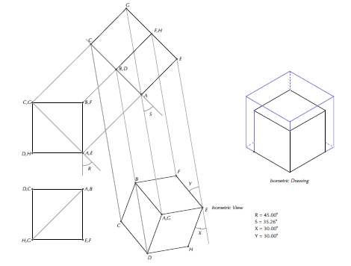
Axonometric projections
Figure 1- An isometric (and axonometric view) of a cube

Slide 22
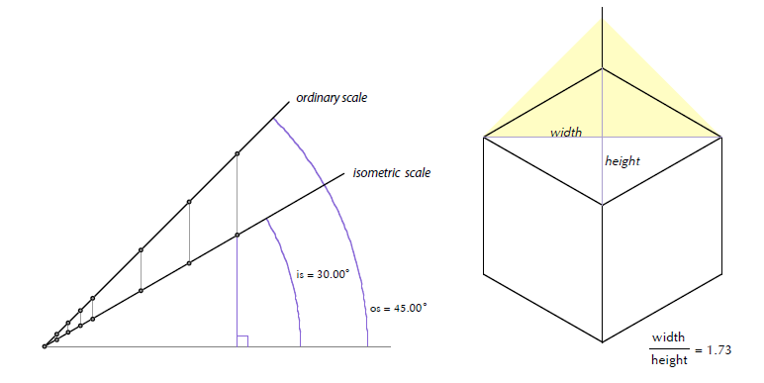
Axonometric projections
Notice that in this view each of the sides of the cube has been foreshortened equally (to 0.8165 of the actual length, or more precisely, √2/√3) and that the indicated angles X and Y are each 30°. Such a projection is also called an isometric projection, meaning equal measure. Isometric views can be drawn directly, as shown in Figure 2 where the view has been rotated until the vertical edge of the cube appears vertical.
Isometric scale for the cube in Figure 2

Slide 23
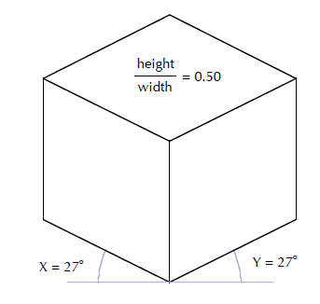
Axonometric projections
The 30° isometric projection has a height to width ratio of 1:√3.
Two other common isometric views are shown in Figures 3 and 4. There are popular projections, which, however, are not true axonometric projections.
The projection shown on the right is a
27° isometric projection (actually,
26°34'12") also known as a 1:2
projection as this is the height to width ratio of the top rhombic face.
Figure 3-1:2 projection

Slide 24
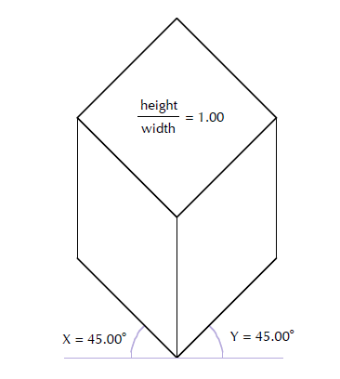
Axonometric projections
The one on the left based is a 45°
isometric view, also known as a military projection. It has a unit height to widthratio.
Figure 4 : Military projection

Slide 25
Oblique Projection
In oblique projection, the direction of projection is not normal to the projection of plane. In oblique projection, we can view the object better than orthographic projection.
There are two types of oblique projections −
Cavalier
Cabinet.
Cavalier
The Cavalier projection makes 45° angle with the projection plane as a result the line of the object length will not change.

Slide 26
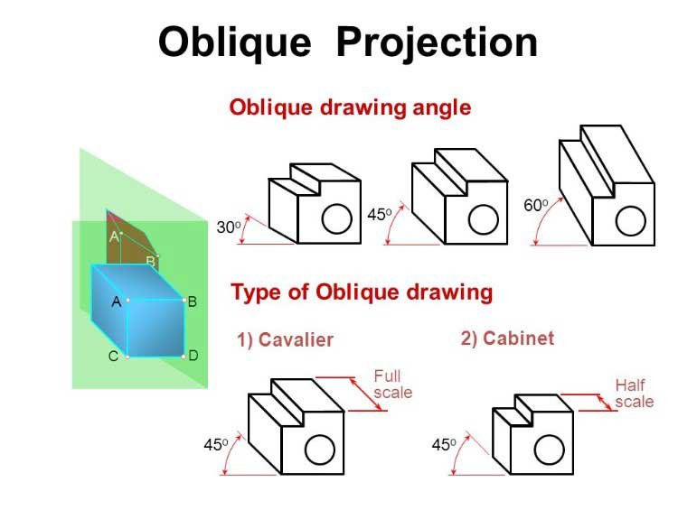
Oblique Projection
The Cabinet projection makes 63.4° angle with the projection plane. In Cabinet projection, lines perpendiculars to the viewing surface are projected at ½ their actual length. Both the projections are shown in the following figure

Slide 27
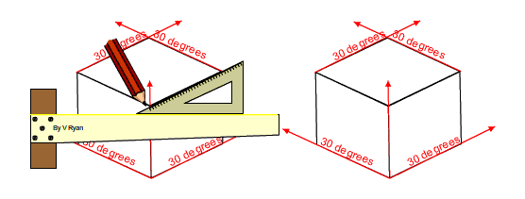
Isometric Projections
Orthographic projections that show more than one side of an object are called axonometric orthographic projections.
The most common axonometric projection is an isometric projection where the projection plane intersects each coordinate axis in the model coordinate system at an equal distance.
In this projection parallelism of lines are preserved but angles are not preserved. The following figure shows isometric projection

Slide 28
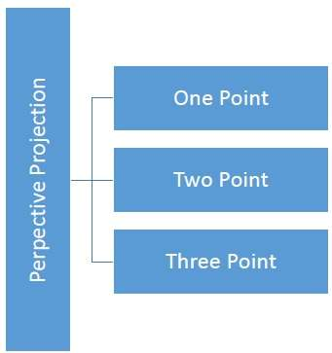
Perspective Projection
In perspective projection, the distance from the center of projection to project plane is finite and the size of the object varies inversely with distance which looks more realistic.
The distance and angles are not preserved and parallel lines do not remain parallel. Instead, they all converge at a single point called center of projection or projection reference point. There are 3 types of perspective projections which are shown in the following chart.

Slide 29
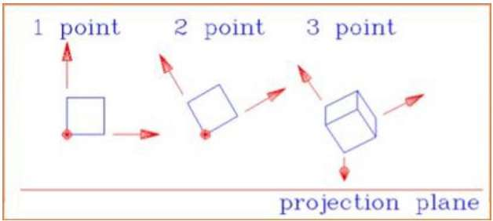
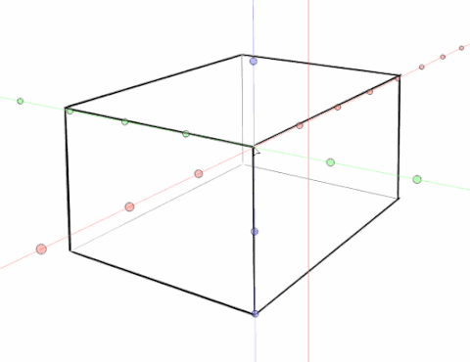
Perspective Projection
The following figure shows all the three types of perspective projection

Slide 30
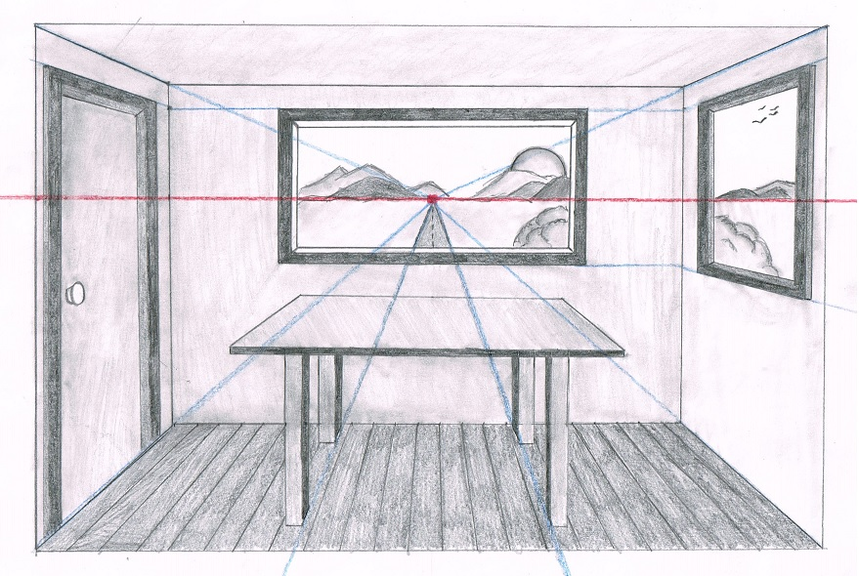
Perspective Projection Type-1
one-point perspective
A one-point perspective drawing means that the drawing has a single vanishing point, usually (though not necessarily) directly opposite the viewer's eye and usually (though not necessarily) on the horizon line. All lines parallel with the viewer's line of sight recede to the horizon towards this vanishing point.

Slide 31
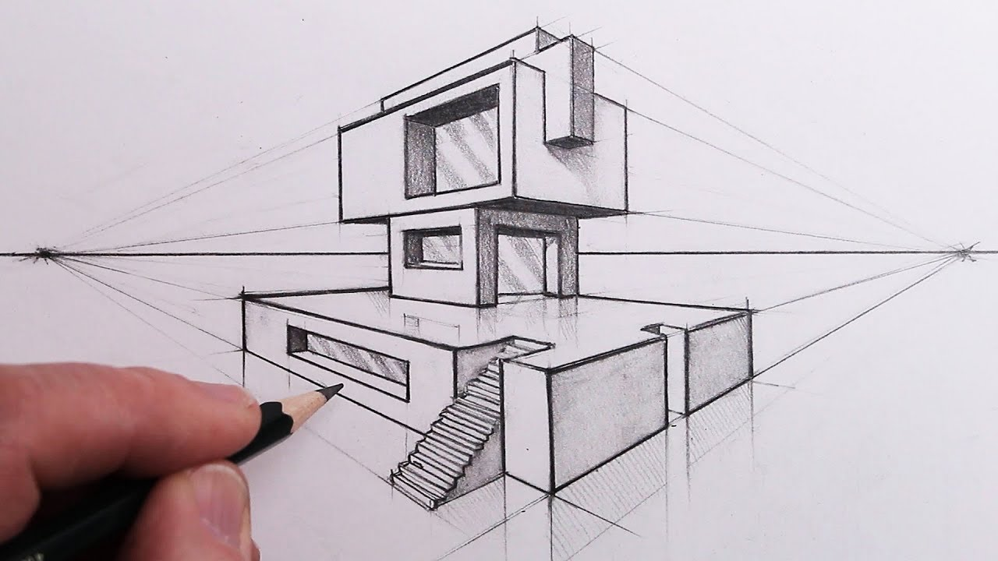
Perspective Projection Type-2
Two point perspective
Two point perspective drawing is a type of linear perspective. Linear perspective is a method using lines to create the illusion of space on a 2D surface. ... One point perspective uses one vanishing point placed on the horizon line. Two point perspective uses two points placed on the horizon line.

Slide 32
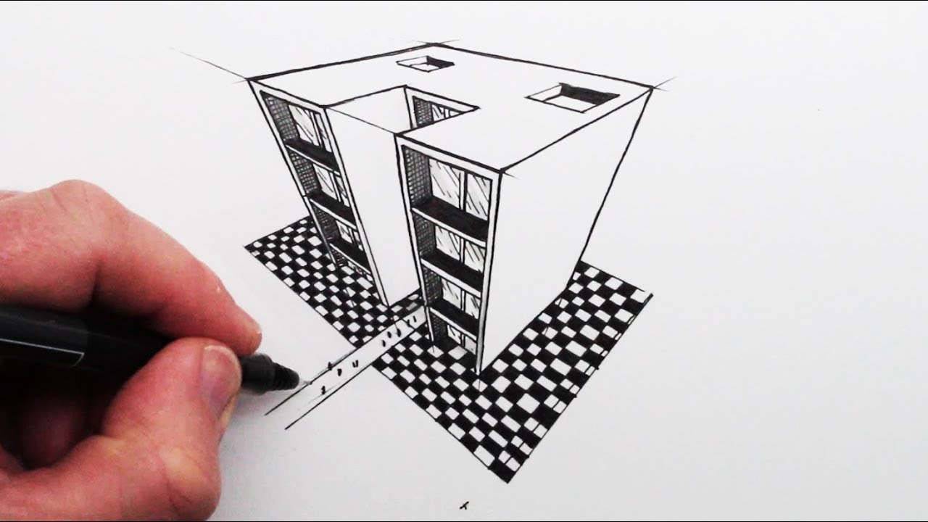
Perspective Projection Type-3
Three-point perspective,
In three-point perspective, all lines recede toward one of the three vanishing points.

Slide 33
Diff b/w Parallel& Perspective Projection
SR.NO | PARALLEL PROJECTION | PERSPECTIVE PROJECTION
1 | Parallel projection represents the object in a different way like telescope. | Perspective projection represents the object in three dimensional way.
2 | In parallel projection, these effects are not created. | In perspective projection, objects that are far away appear smaller, and objects that are near appear bigger.
3 | The distance of the object from the center of projection is infinite. | The distance of the object from the center of projection is finite.

Slide 34
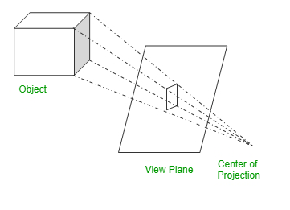
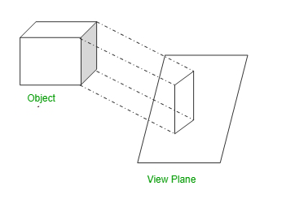
Diff b/w Parallel& Perspective Projection
SR.NO | PARALLEL PROJECTION | PERSPECTIVE PROJECTION
4 | Parallel projection can give the accurate view of object. | Perspective projection cannot give the accurate view of object.
5 | The lines of parallel projection are parallel. | The lines of perspective projection are not parallel.
6 | Projector in parallel projection is parallel. | Projector in perspective projection is not parallel.

Slide 35
Diff b/w Parallel& Perspective Projection
SR.NO | PARALLEL PROJECTION | PERSPECTIVE PROJECTION
7 | Two types of parallel projection : 1.Orthographic, 2.Oblique | Three types of perspective projection: 1.one point perspective, 2.Two point perspective, 3. Three point perspective,
8 | It does not form realistic view of object. | It forms a realistic view of object.

Slide 36
Visible Surface Detection
Visible→ What ever that we able to see
Surface→ Any Object/Image
What ever your are able to see that has to be detected what ever that you are not able to see that can be Removed or Discarded
Visible Surface Detection can be called as Hidden Surface Removal.
What ever that you not able to see its a Wastage
To avoid the wastage we are going to Remove what ever that are not able to see.
Visible Surface Detection is to identify the parts of a Scene that are visible from a Chosen Viewing position

Slide 37
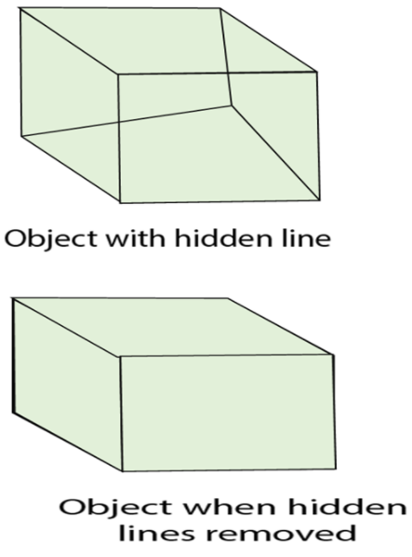
Visible Surface Detection

Slide 38
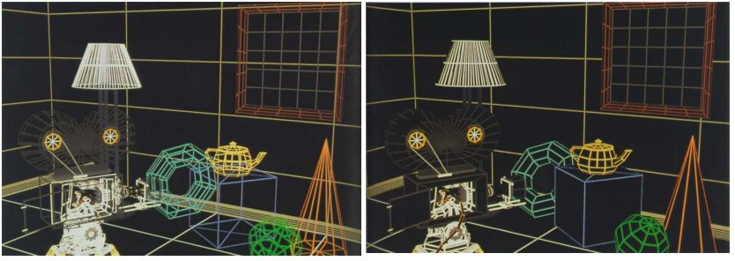
Visible Surface Detection

Slide 39
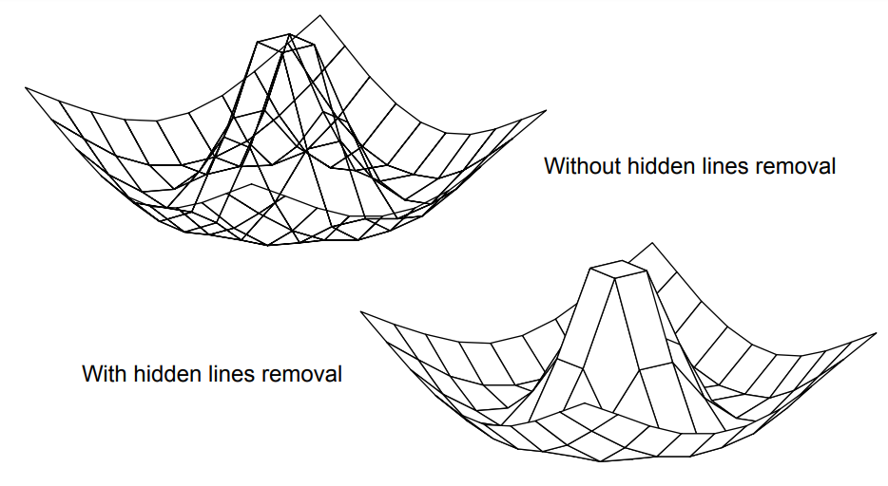
Visible Surface Detection

Slide 40
Visible Surface Detection
Two Approaches for Removing Hidden Surface
Object Space Method(Continuous)
Image Space Method (Discrete)
Object Space Method
It is implemented in the physical Coordinate System
Compare objects and parts of objects to each other within the scene definition to determine which surfaces, as a whole, we should label as visible
Image Space Method
It is implemented in the Screen Coordinate System
Visibility is determined point by point at each pixel position on the projection plane.

Slide 41
Coherence properties
Object Coherence – If one object is entirely separate from another, do not compare.
Face Coherence – smooth variations across a face; incrementally modify.
Edge Coherence – Visibility changes if a edge crosses behind a visible face.
Implied edge coherence – Line of intersection of a planar face penetrating another, can be obtained from two points on the intersection.
Scanline coherence – Successive lines have similar spans.
Area Coherence – Span of adjacent group of pixels is often covered by the same visible face.
Depth Coherence – Use difference equation to estimate depths of nearby points on the same surface.
Frame Coherence – Pictures of two successive frames of an animation sequence are quite similar (small changes in object and viewpoint).

Slide 42
Visible Surface Detection
Characteristics of Three Approaches
Requires large memory size?
Requires large/long Processing time ?
Applicable to which type of object ?
Factors
Complexity of the Scene
Type of object in the Scene
Available Equipments
Static or Animated

Slide 43
Visible Surface Detection
Different Types of Visible Surface Detection
Back-Face Detection Method
Depth buffer(Z-Buffer)
Scan Line Method
Depth Sorting Method
Area Subdivision Method
BSP-Tree Method
Octree Method
A- Buffer Method

Slide 44
1.Back-Face Detection Method
This method follows Object space method
Backspace Detection Method is implemented in physical coordinate system
In a solid object, there are surfaces which are facing the viewer (front faces) and there are surfaces which are opposite to the viewer (back faces).
These back faces contribute to approximately half of the total number of surfaces. Since we cannot see these surfaces anyway, to save processing time, we can remove them before the clipping process with a simple test.

Slide 45
1.Back-Face Detection Method
Test –”inside-outside” test ,Consider a point (x,y,z) is inside the polygon surface
Ax+By+Cz+D <0 we can say the point is inside the polygon ,If it is inside the polygon means it is backside to the object , we can remove it
Each surface has a normal vector. If this vector is pointing in the direction of the center of projection, it is a front face and can be seen by the viewer. If it is pointing away from the center of projection, it is a back face and cannot be seen by the viewer.

Slide 46
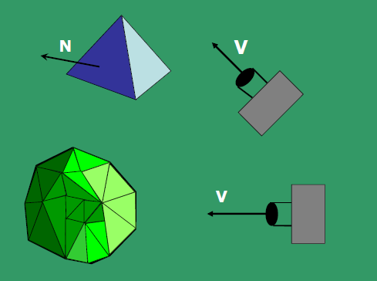
1.Back-Face Detection Method

Slide 47
1.Back-Face Detection Method
The test is very simple, suppose the z axis is pointing towards the viewer, if the z component of the normal vector is negative, then, it is a back face. If the z component of the vector is positive, it is a front face.
Advantages
It is simple and straight forward method
It reduce the size of the database

Slide 48
2.Depth-Buffer(Z-Buffer) Algorithm
Z-buffering, also known as depth buffering, is a technique in computer graphics programming. It is used to determine whether an object (or part of an object) is visible in a scene. It can be implemented either in hardware or software, and is used to increase rendering efficiency.
When scenes are rendered, each pixel has X and Y coordinates (horizontal and vertical orientation to the camera), and a Z coordinate (distance from the camera).
The Z buffer is a two-dimensional array (X and Y) that stores the Z-value of each screen pixel. If another object must be rendered at the same pixel location, the algorithm overrides the previous value if the new pixel is closer to the camera.

Slide 49
2.Depth-Buffer(Z-Buffer) Algorithm
This algorithm increases rendering speed for opaque objects, but transparent objects do not benefit since the distant objects are partially visible and must be fully rendered.
Follows image space Approach
Depth-Buffer(Z-Buffer) is implemented in screen coordinate system
Basic ides is used to test Z-Depth of each surface to determine the closest visible surface
To override the closer polygons from the far ones we are going to use two buffers
Frame Buffer/Image Buffer
Depth buffer

Slide 50
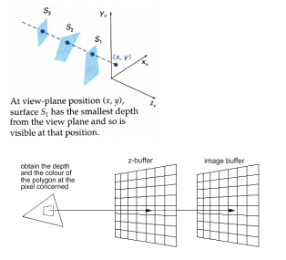
2.Depth-Buffer(Z-Buffer) Algorithm

Slide 51
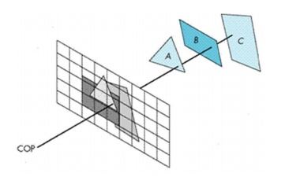
2.Depth-Buffer(Z-Buffer) Algorithm

Slide 52
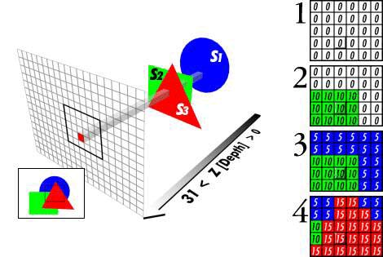
2.Depth-Buffer(Z-Buffer) Algorithm

Slide 53
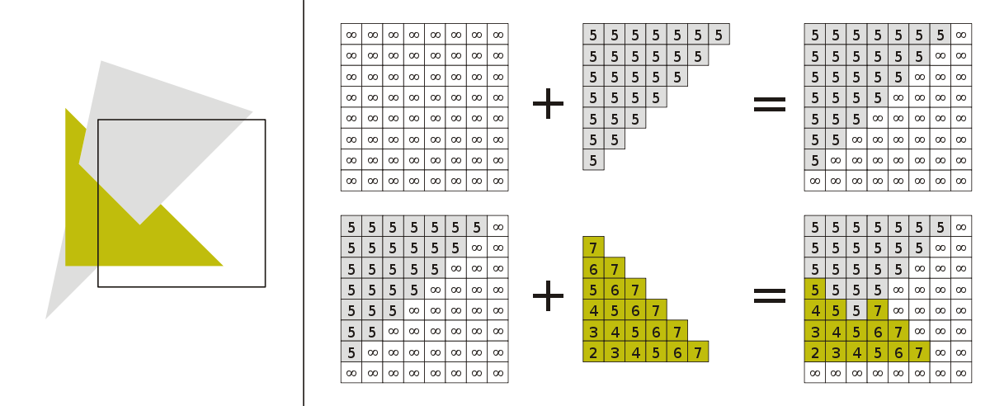
2.Depth-Buffer(Z-Buffer) Algorithm

Slide 54
2.Depth-Buffer(Z-Buffer) Algorithm
This method requires 2 buffers: one is the image buffer and the other is called the z-buffer (or the depth buffer). Each of these buffers has the same resolution as the image to be captured.
Frame buffer/Image Buffer
Is used to store the intensity value of colour at each position (x,y)
Depth buffer
Is used to store the depth values for (x,y)

Slide 55
2.Depth-Buffer(Z-Buffer) Algorithm
Algorithm:
Initially each pixel of the z-buffer is set to the maximum depth value (the depth of the back clipping plane).
The image buffer is set to the background color.
Surfaces are rendered one at a time.
For the first surface, the depth value of each pixel is calculated
If this depth value is smaller than the corresponding depth value in the z-buffer (ie. it is closer to the view point), both the depth value in the z-buffer and the color value in the image buffer are replaced by the depth value and the color value of this surface calculated at the pixel position.

Slide 56
2.Depth-Buffer(Z-Buffer) Algorithm
6. Repeat step 4 and 5 for the remaining surfaces.
7. After all the surfaces have been processed, each pixel of the image buffer represents the color of a visible surface at that pixel
Limitations of Depth Buffer
The depth buffer Algorithm is not always practical because of the enormous size of depth and intensity arrays.
Generating an image with a raster of 500 x 500 pixels requires 2, 50,000 storage locations for each array.
Even though the frame buffer may provide memory for intensity array, the depth array remains large.

Slide 57
2.Depth-Buffer(Z-Buffer) Algorithm
To reduce the amount of storage required, the image can be divided into many smaller images, and the depth buffer algorithm is applied to each in turn.
For example, the original 500 x 500 raster can be divided into 100 rasters each 50 x 50 pixels.
Processing each small raster requires array of only 2500 elements, but execution time grows because each polygon is processed many times.
Subdivision of the screen does not always increase execution time instead it can help reduce the work required to generate the image. This reduction arises because of coherence between small regions of the screen.

Slide 58
Scan Line Algorithm
It is an image space algorithm. It processes one line at a time rather than one pixel at a time.
It uses the concept area of coherence. This algorithm records edge list, active edge list. So accurate book keeping is necessary.
The edge list or edge table contains the coordinate of two endpoints. Active Edge List (AEL) contain edges a given scan line intersects during its sweep.
The active edge list (AEL) should be sorted in increasing order of x. The AEL is dynamic, growing and shrinking.

Slide 59
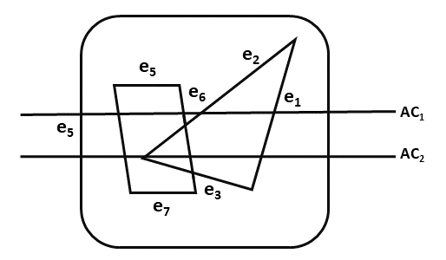
Scan Line Algorithm
Following figures shown edges and active edge list. The active edge list for scan line AC₁contain e₁,e₂,e₅,e₆ edges.
Scan line can deal with multiple surfaces.
As each scan line is processed, this line will intersect many surfaces.
The intersecting line will determine which surface is visible.
Depth calculation for each surface is done.

Slide 60
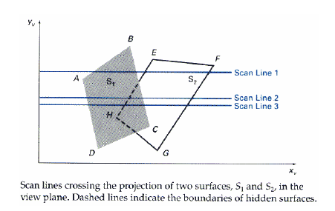
Scan Line Algorithm
The surface rear to view plane is defined.
When the visibility of a surface is determined, then intensity value is entered into refresh buffer.

Slide 61
Depth-Sort Method
1. Sort all surfaces according to their distances from the view point.
2. Render the surfaces to the image buffer one at a time starting from the farthest surface.
3. Surfaces close to the view point will replace those which are far away.
4. After all surfaces have been processed, the image buffer stores the final image.
The basic idea of this method is simple. When there are only a few objects in the scene, this method can be very fast. However, as the number of objects increases, the sorting process can become very complex and time consuming.

Slide 62
Depth-Sort Method
Example:
Assuming we are viewing along the z axis.
Surface S with the greatest depth is then compared to other surfaces in the list to determine whether there are any overlaps in depth.
If no depth overlaps occur, S can be scan converted. This process is repeated for the next surface in the list.
However, if depth overlap is detected, we need to make some additional comparisons to determine whether any of the surfaces should be reordered.

Slide 63
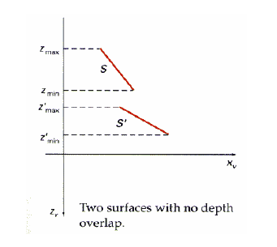
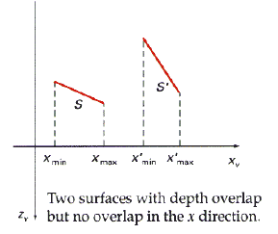
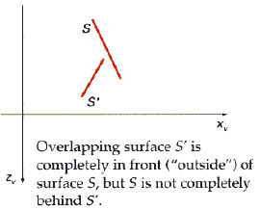
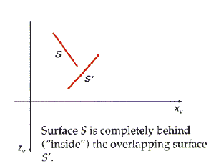
Depth-Sort Method

Slide 64
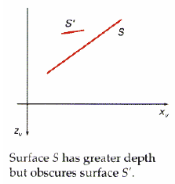
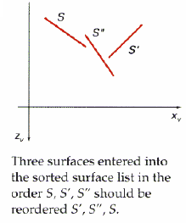
Depth-Sort Method
In case if there are any overlaps in depth, we need to make some additional comparisons to determine whether a pair of surfaces should be reordered. The checking is as follows:

Slide 65
Depth-Sort Method
a. The bounding rectangles in the xy plane for the 2 surfaces do not overlap
b. The surface S with greater depth is completely behind the overlapping surface relative to the viewing position.
C. The overlapping surface is completely in front of the surface S with greater depth relative to the viewing position.
d. The projections of the 2 surfaces onto the view plane do not overlap.
If any of the above tests is passed, then the surfaces no need to be re-ordered.

Slide 66
Area Subdivision Algorithm
It was invented by John Warnock and also called a Warnock Algorithm.
It is based on a divide & conquer method.
It uses fundamental of area coherence.
It is used to resolve the visibility of algorithms.
It classifies polygons in two cases i.e. trivial and non-trivial.
Trivial cases are easily handled. Non trivial cases are divided into four equal subwindows.
The windows are again further subdivided using recursion until all polygons classified trivial and non trivial.

Slide 67
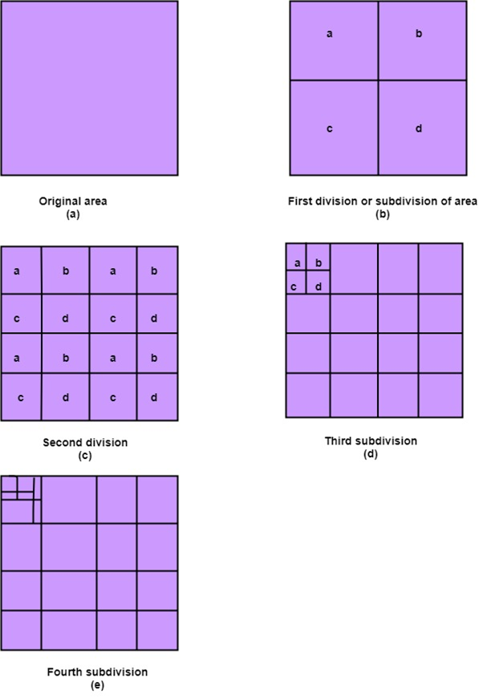
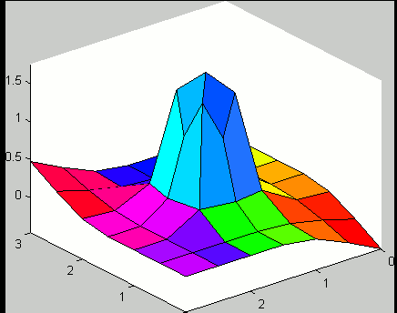
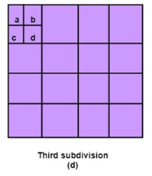
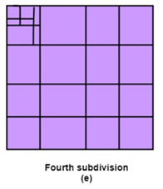
Area Subdivision Algorithm

Slide 68
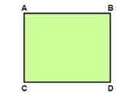
Area Subdivision Algorithm
Classification of Scheme
It divides or classifies polygons in four categories:
Inside surface
Outside surface
Overlapping surface
Surrounding surface
Fig 1 ABCD is Current Window against which particular window is determined
to be of either of four categories

Slide 69
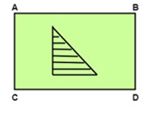
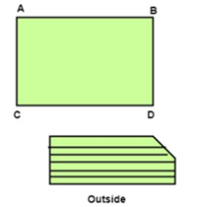
Area Subdivision Algorithm
1. Inside surface: It is surface which is completely inside the surrounding window or specified boundary as shown in Fig 1.1
2. Outside surface: The polygon surface completely outside the surrounding window as shown in Fig 1.2.
Fig 1.1 Surface is Inside specified Window
Fig 1.2 Surface is Outside specified Window

Slide 70


Area Subdivision Algorithm
3. Surrounding surface: It is polygon surface which completely encloses the surrounding window as shown in Fig 1.3
4. Overlapping surface: It is surface partially inside or partially outside the surface area as shown in Fig 1.4
Fig 1.3 Surface completely Encloses Surrounding Window
Fig 1.4 Surface of object intersecting desired Window

Slide 71
BSP –Tree Method
The binary space Partitioning Tree method is very effective in determining visibility relationship among a static group of 3D polygons as seen from arbitrary viewpoint
Procedure
Select polygon as the root of the tree i.e the 1st partition plane
Partition the object space into two half-spaces (inside & outside of the partition plane determined by the normal to the plane); some object polygon lie in the rear half while the others in the front half w.r.t. The partition plane

Slide 72
BSP –Tree Method
If a polygon is intersected by the partition plane, split it into two polygons so that they belong to different half spaces
Select one polygon in the roots front as the left node or child and another in the roots back as the right node or child
Recursively subdivide spaces considering the plane of the children's as partition planes until a subspace contains a single polygon

Slide 73


BSP –Tree Method Example

Slide 74
BSP –Tree Method
Disadvantage of BSP:
Generating a BSP tree can be time-consuming.
BSP does not solve the problem of visible surface determination.
Uses of BSP:
It is used in collision detection in 3D video games and robotics.
It is used in ray tracing
It is involved in the handling of complex spatial scenes.

Slide 75
A-Buffer Algorithm
This method is also known as anti-aliased or area-averaged or accumulation buffer.
This method extends the algorithm of depth-buffer (or Z Buffer) method.
As the depth buffer method can only be used for opaque object but not for transparent object, the A-buffer method provides advantage in this scenario.
Although the A buffer method requires more memory, but different surface colors can be correctly composed using it.
Being a descendent of the Z-buffer algorithm, each position in the buffer can reference a linked list of surfaces. The key data structure in the A buffer is the accumulation buffer.

Slide 76
A-Buffer Algorithm
Each position in the A buffer has 2 fields : 1) Depth field 2) Surface data field or Intensity field
A depth field stores a positive or negative real number. A surface data field can stores surface intensity information or a pointer to a linked list of surfaces that contribute to that pixel position.
when a pixel overlap by one surface
As shown in the above figure, if the value of depth is >= 0, the number stored at that position is the depth of single surface overlapping the corresponding pixel area.
Depth >=0 | RGB and other information

Slide 77

A-Buffer Algorithm
The 2nd field, i.e, the intensity field then stores the RGB components of the surface color at that point and the percent of pixel coverage.
As shown in the above figure, multiple-surface contributions to the pixel intensity is indicated by depth < 0. The 2nd field, i.e, the intensity field then stores a pointer to a linked list of surface data.
A buffer method is slightly costly than Z-buffer method because it requires more memory in comparison to the Z-buffer method.

Slide 78

A-Buffer Algorithm
It proceeds just like the depth buffer algorithm.
Here, the depth and opacity are used to determine the final color of the pixel.
As shown in the figure below, the A buffer method can be used to show the transparent objects.

Slide 79
A-Buffer Algorithm
The surface buffer in the A buffer method includes :
Depth
Surface Identifier
Opacity Parameter
Percent of area coverage
RGB intensity components
Pointer to the next surface
The other advantage of A buffer method is that it provides anti-aliasing in addition to what Z-buffer does.

Slide 80

A-Buffer Algorithm
The usage of A-buffer algorithm for the transparent surfaces is as shown below
On applying the A-buffer method on all the six surfaces indicated below, the corresponding colors are as :

Slide 81

A-Buffer Algorithm
In A-buffer method, each pixel is made up of a group of sub-pixels. The final color of a pixel is computed by summing up all of its sub-pixels. Due to this accumulation taking place at sub-pixel level, A-buffer method gets the name accumulation buffer.

Slide 82

Ray Tracing

Slide 83

Ray Tracing

Slide 84
Ray Tracing
Firstly without light we cannot see anything and Secondly without object in our environment, we cannot see light.
Ray tracing is a technique for rendering three dimensional graphics with very complex light interactions. This means you can create pictures full of mirrors, transparent surfaces and shadows with stunning results.
A simple method to both understand and implement.
It is based on the idea that you can model reflection and refraction by recursively following the path that light takes as it bounces through an environment.
Builds the image pixel by pixel

Slide 85



Ray Tracing
Cast additional rays from the hit point to determine the pixel color.
Shoot rays toward each light. If they hit something, the object is shadowed from that light, otherwise use “standard model” for the light
Reflection rays for mirror surfaces, to see what should reflect in the mirror.
Refraction rays to see what can be seen through transparent objects
Sum all the contributions to get the Pixel color

Slide 86


Ray Tracing

Slide 87

Ray Tracing-Example

Slide 88
Illumination Models
Illumination model, also known as Shading model or Lightning model, is used to calculate the intensity of light that is reflected at a given point on surface. There are three factors on which lightning effect depends on:
Light Source:
Light source is the light emitting source. There are three types of light sources:
Point Sources – The source that emit rays in all directions (A bulb in a room).
Parallel Sources – Can be considered as a point source which is far from the surface (The sun).
Distributed Sources – Rays originate from a finite area (A tubelight).
Their position, electromagnetic spectrum and shape determine the lightning effect.

Slide 89

Light Source
a. Point Sources
b. Parallel Sources
Distributed Sources

Slide 90

Illumination Models

Slide 91
Illumination Models
Surface : When light falls on a surface part of it is reflected and part of it is absorbed. Now the surface structure decides the amount of reflection and absorption of light. The position of the surface and positions of all the nearby surfaces also determine the lightning effect.
Observer : The observer’s position and sensor spectrum sensitivities also affect the lightning effect.

Slide 92

Ambient Illumination
Ambient Illumination :
Assume you are standing on a road, facing a building with glass exterior and sun rays are falling on that building reflecting back from it and the falling on the object under observation.
This would be Ambient Illumination. In simple words, Ambient Illumination is the one where source of light is indirect.

Slide 93

Ambient Illumination
The reflected intensity I_{amb} of any point on the surface is:
Iamb=IaKa
Ia = intensity of ambient light
ka= percentage of the light reflected by the object

Slide 94


Diffuse Reflection
2. Diffuse Reflection : Diffuse reflection occurs on the surfaces which are rough or grainy like clay, soil, fabric. In this reflection the brightness of a point depends upon the angle made by the light source and the surface.
The reflected intensity I_{diff} of a point on the surface is:

Slide 95

Diffuse Reflection
The brightness at each point is proportional to cos( θ )
Brightness is proportional to cos( θ) because a surface
(a) perpendicular to the light direction is more illuminated than a surface (b) at an oblique angle

Slide 96

Diffuse Reflection
Example: diffuse reflection from different light directions

Slide 97

Specular Reflection
3. Specular Reflection :
When light falls on any shiny or glossy surface most of it is reflected back, such reflection is known as Specular Reflection.
An ideal specular surface (mirror) reflects light exclusively in one direction: R • Glossy objects are not ideal mirrors and reflect in the immediate vicinity of R

Slide 98


Specular Reflection
The Phong Model: reflected specular intensity falls off as some power of cos ( φ):
K s - the surface specular reflectivity
n – specular reflection parameter, determining the deviation from ideal specular surface (for a perfect mirror n= ∞ )

Slide 99

Specular Reflection
The Phong Model: plots of cos n ( φ) for three values of the specular parameter n

Slide 100


Specular Reflection
The illumination equation combined with diffuse reflection is:
If k light sources are present in the scene:

Slide 101

Specular Reflection

Slide 102

Specular Reflection

Slide 103

Specular Reflection

Slide 104

Composing Light Source

Slide 105
Specular Reflection
Specular reflection can have its own colour.
A snooker ball’s highlight is the colour of the light, not the colour of the ball.
Several specular models exist
Phong
Basic, but good output
Cook-Tor
Optimised version of Phong, handles hardness
Blinn
Also handles softness of highlight
Toon
Simulates cartoon style shading
Play about with these in Blender.

Slide 106
Shading
How do we color the whole surface?
At first, the illumination model computes the color of sample points
While doing the colouring the entire object, this is done at the rasterization level.
The procedure to color the entire surface is called Shading
Shading is a technique for finding intensity profile of a surface as whole to simulate its appearance under given lighting condition. Such techniques call for implementation of illumination model at each visible point of surfaces defined by polygon meshes

Slide 107
Shading
Shading is an important part of creating realistic objects.
It adds nuance and definition to otherwise flat representations.
Illumination may fall unevenly across a polygon.
Can be calculated individually for each pixel.
Expensive to calculate.
Faster shading algorithms exist
There are several key determinants in the level of shading across a polygon.
Surface properties
Texture
Colour
Material

Slide 108

Shading
Light sources
Relative positions and orientations
Shading is important as a mechanism for conveying information about 3D shapes in 2D.
Representation of shapes with single colours render the images as 2D to our eyes.

Slide 109
LOCAL RENDERING OF LIGHT
Modelled in one of three ways.
Perfect specular reflection.
Light is reflected directionally.
Imperfect specular reflection.
Light is reflected imperfectly
Perfect diffuse reflection
Light is scattered in all directions.
These three models can be used to determine the shading of polygons.

Slide 110

FLAT SHADING
Flat shading works by applying a single pixel colour across an entire polygon.
It cannot handle specular reflection.
Very quick and efficient, but realism is limited.
Especially for low polygon counts.
Separate polygons are clearly visible.

Slide 111
FLAT SHADING
The human eye is especially good at noticing edges.
Flat shading is thus acting against our biology.
Better results can be obtained by interpolation of shading across a polygon’s surface.
Common technique for this is GouraudShading.
Used when polygons are approximating curved surfaces.
This provides a linear colour gradient over the polygon.

Slide 112

Gouraud Shading.
First, must calculate vertex intensity.
Simple method is to average the light intensity of all polygons sharing a vertex.
More complex method involves modelling light interaction at each vertex.
More computation, but more realistic output.

Slide 113

Gouraud Shading.
Light intensity at each vertex used to calculate light intensity of pixels in polygon.

Slide 114


FLAT VERSUS GOURAUD
Flat Shading Model – note
individual polygons easily
identifiable.
Gouraud Shading Model –
interpolation of pixel colours
across polygons hides edges
better.

Slide 115

FLAT SHADING

Slide 116

GOURAUD SHADING

Slide 117

PHONG REFLECTION MODEL
The Phong Reflection Model works by estimating the colours of pixels.
Light described as the combination of:
Ambient light
Diffuse light
Specular Light

Slide 118
PHONG SHADING
Problem of visible edges mitigated by Gouraud shading
Not eliminated
Minimum and maximum intensity will always occur at vertexes.
Calculation works on the basis of interpolation.
Interpolation works slightly differently.

Slide 119
SURFACE NORMALS
When determining the way light interacts with a polygon, we base it on the surface normal.
A hypothetical line that extends perpendicularly from the point.
With flat shading, we base the intersection on the surface normal of the middle pixel of a polygon.
This gives a rough measure of light intensity.
With Gouraud, we base it on the intensity of each vertex.
More nuanced.

Slide 120


PHONG SHADING
Phong Shading interpolates the surface normals across a polygon.
Intensity is estimated based on these interpolated normals.
Phong Shading

Slide 121

Ray Tracing
What is ray tracing
Ray tracing is a technique for rendering three dimensional graphics with very complex light interactions. This means you can create pictures full of mirrors, transparent surfaces, and shadows, with stunning results.
A very simple method to both understand and implement.
It is based on the idea that you can model reflection and refraction by recursively following the path that light takes as it bounces through an environment

Slide 122

Ray Tracing

Slide 123

Ray Tracing Model

Slide 124

Ray Tracing Image

Slide 125
Ray tracing algorithm
Builds the image pixel by pixel
Cast additional rays from the hit point to determine the pixel color
Shoot rays toward each light. If they hit something, the object is shadowed from that light, otherwise use “standard model” for the light
Reflection rays for mirror surfaces, to see what should be reflected in the mirror
Refraction rays to see what can be seen through
transparent objects
Sum all the contributions to get the pixel color

Slide 126
Recursive ray tracing
When a reflected or refraction ray hits a surface, repeat the whole process from that point
Send more out shadow rays
Send out new reflected rays (if required)
Send out a new refracted ray (if required)
Generally, reduce the weight of each additional ray when computing the contributions to the surface color
Stop when the contribution from a ray is too small to notice or maximum recursion level has been reached

Slide 127
Ray tracing implementation
Ray tracing breakdown into two tasks
– Constructing the ray to cast
– Intersection rays with geometry
The former problem is simple vector arithmetic
Intersection calculation can be done in world coordinates or model coordinates

Slide 128
Constructing Rays
Define rays by an initial point and a direction: x(t)=x0+td
Eye rays: Rays from the eye through a pixel
Construct using the eye location and the pixel’s location on the image plane. X0 = eye
Shadow rays: Rays from a point on a surface to the light.
X0 = point on surface
Reflection rays: Rays from a point on a surface in the reflection direction
Construct using laws of reflection. X0 = surface point
Transmitted rays: Rays from a point on a transparent surface through the surface
Construct using laws of refraction. X0 = surface point

Slide 129


Slide 130


Texture
A detailed pattern that is repeated many times to tile the plane.
Texture mapping is a powerful technique for adding realism to a computer generated scene.
Texture Mapped on to Tea Pot

Slide 131

Texture
The First use of texture was developed by Catmull in the year 1974.
Algorithm is applied to bicubic parametric patch model, since the parametric patch models already possesses the U,V values everywhere on its surface.
How is texture mapping done
Two Dimensional Texture Mapping

Slide 132
Algorithm
The Algorithm divides the surface patch in object space.
At the same time , executes subdivision in texture space.
Patch subdivision proceeds until it ends in single pixel.
After it reached this point, Subdivision process terminates .
The required texture value for each pixel is obtained from texture domain.
Difficulties
Two difficulties
Inventing suitable surface parameterization
Anti-aliasing.

Slide 133
Types of Texture Mapping
Two Types
Forward texture mapping
computing 3D positions of the texture points and then projecting them onto the image plane.
Inverse texture mapping
selecting every pixel in the image plane and finding what point of the texture plane is projected there.

Slide 134
Drawbacks
Forward Texture mapping :
Adjacent texture points may project onto non adjacent image points, thus creating a non colored area .
Inverse Texture Mapping :
Aliasing would appear, if sampling the texture map is done at a frequency higher than its Nyquist rate.
Nyquist rate
the minimum theoretical sampling rate .

Slide 135
REFERENCES
Alan Watt, 3D Computer graphics . Addison – Wesley 1993.
Fredrick M Weinhaus, Venkat Devarajan,Texture mapping 3D models of real-world scenes .ACM computing survey , Volume 29 1997.
James F. Blinn and Martin E. Newel,Texture and Reflection in computer generated images. ACM computing survey.
http://www.cs.csustan.edu/~rsc/CS3600F00/TextureMapping.pdf
http://www.sgi.com/grafica/texmap/index.html
http://www-2.cs.cmu.edu/~ph/texsurv.pdf

